Slide 1
Final Project Proposal
Nemo Cedillo

Slide 2
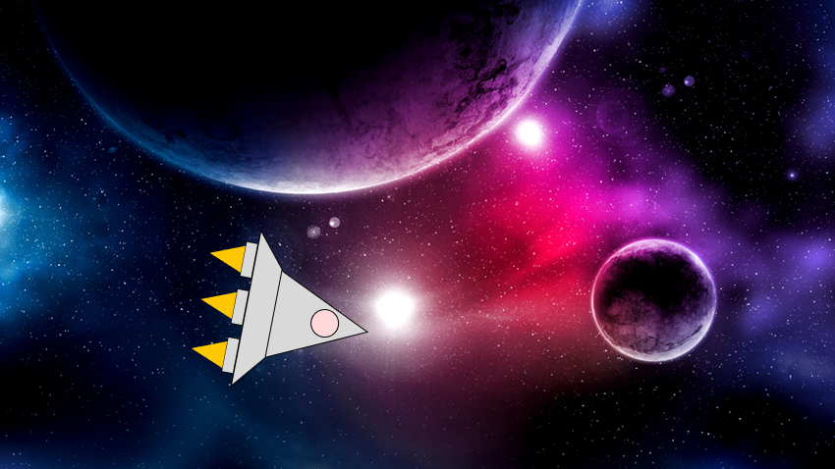
Intergalatic Shooter Game
Client is able to travel to different planets and complete missions in a simple manner.

Slide 3
Client
Gamers
Gamers who like a simple, but adventurous game.
Able to play game.
Keep High Score

Slide 4
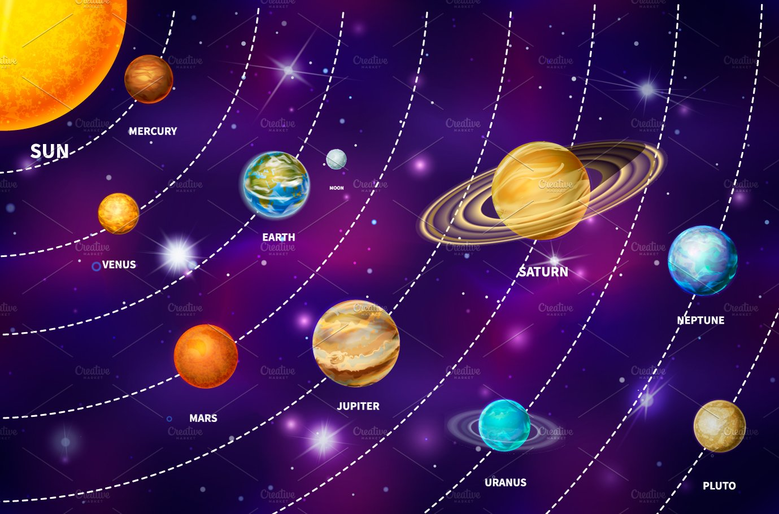
Client Component : Selecting a planet
Client will be able to:
Select a planet to travel to.

Slide 5
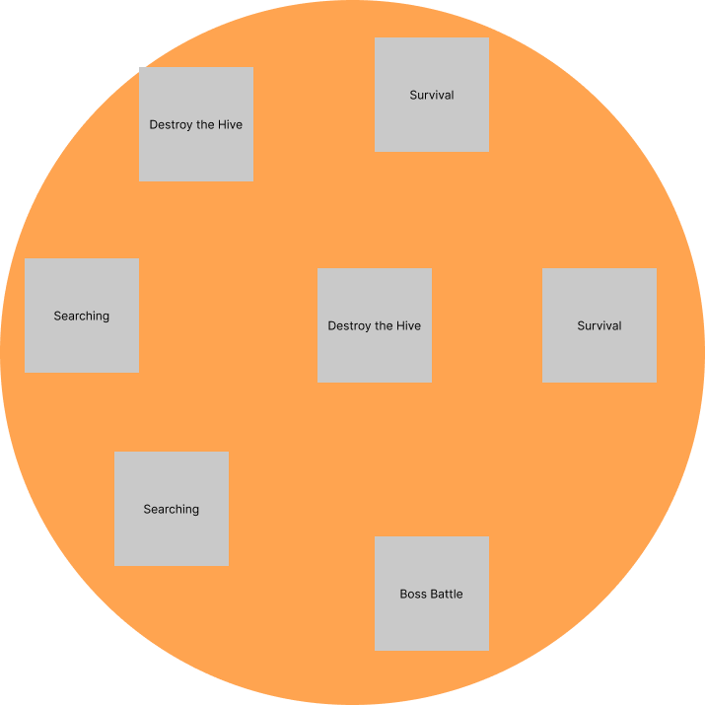
Client : Selecting a Mission.
Client is able to select a mission on each planet.
Planet missions will randomize.

Slide 6
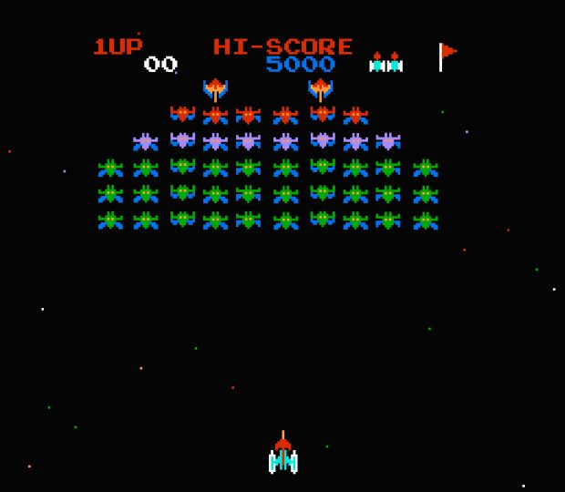
Client Component : Selecting a level
- Looks similar to Galaga.

Slide 7
Web Component
Logging Where the Player has been.
Logging Statistics of the Player
Keep data on planets the player has been to.
# of Levels / Missions the player has been on.
How many aliens / enemies the player destroyed.
Specific stats of each enemy type.

Slide 8
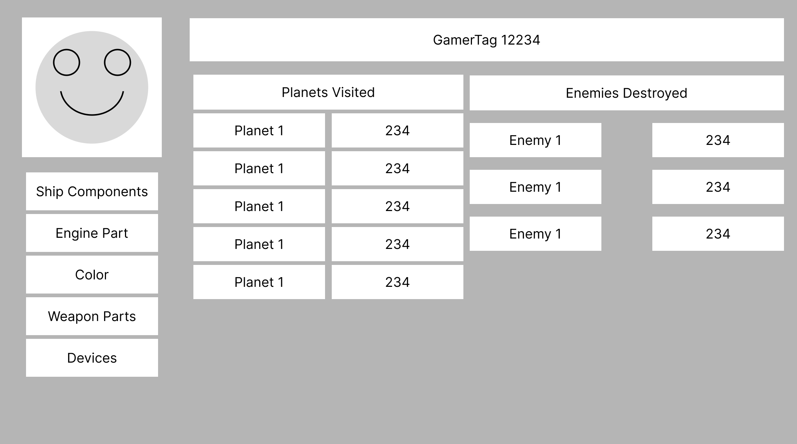
Rough Draft Interface

Slide 9
Data Component
Store Statistics of Player
Keep Player Data
Stores statistics including:
Missions Completed
Enemies Destroyed
Ship Components
Allows the player to play the game anywhere.
Stores data so the player can pick it back up anytime.

Slide 10
Potential Challenges
Uploading Data from the Game
Getting Data from the Web to Game.
Uploading data to the web.
Finding a way to transfer data.
Make the player’s data accessible anywhere.

